Slide 1
Google form
Mahesh Kunchapkar
FYIT-43

Slide 2
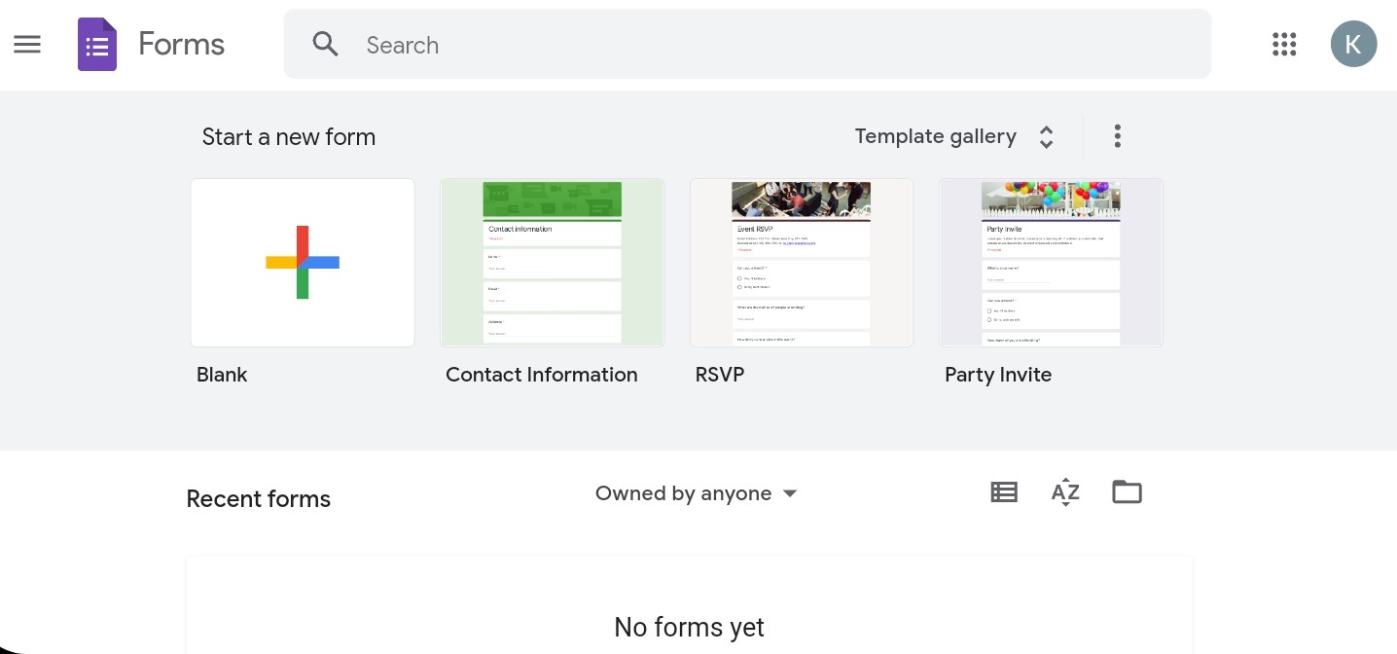
Working
Set up a new form or quiz.
Edit and format a form or quiz.
Send your form for people to fill out.
Mahesh Kunchapkar
FYIT-43

Slide 3
Features
Shuffle of questions for randomised order
Limited responses for a person
Shorter URLs
Upload File
Event Registration
Opinion Poll
Mahesh Kunchapkar
FYIT-43

Slide 4
THANK YOU
Mahesh Kunchapkar
FYIT-43

